Slide 1

Learning from failure: ETHICAL PITFALLS in project management
Ransford Nana Addo Jnr EMBA CFE , PCI , CFC , CCO.
PMI 2024 Conference

Slide 2


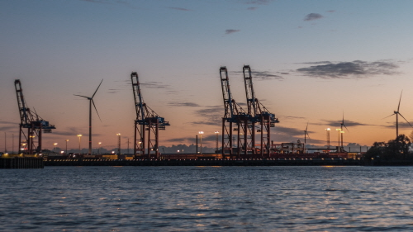


Association of Certified Fraud Examiners latest Report to the Nations reveals that Organizations loss 5% of their annual to fraud.
PWC states that 52% of Businesses experienced fraud in the last 24months. Global Economic Crime & Fraud Survey 2022
My Dilemma of “Ps”
Projects are initiated because there are problems to deal with.
Do we get into Problems to solve problems or create more problems?
Ghana may soon be importing water due to the destruction of water bodies.
Ghana may import water from 2030 - Lands Minister (ghanaweb.com)
Accra is the Most Polluted City in Africa the 7th in the world . https://www.iqair.com/world-air-quality-ranking

Slide 3
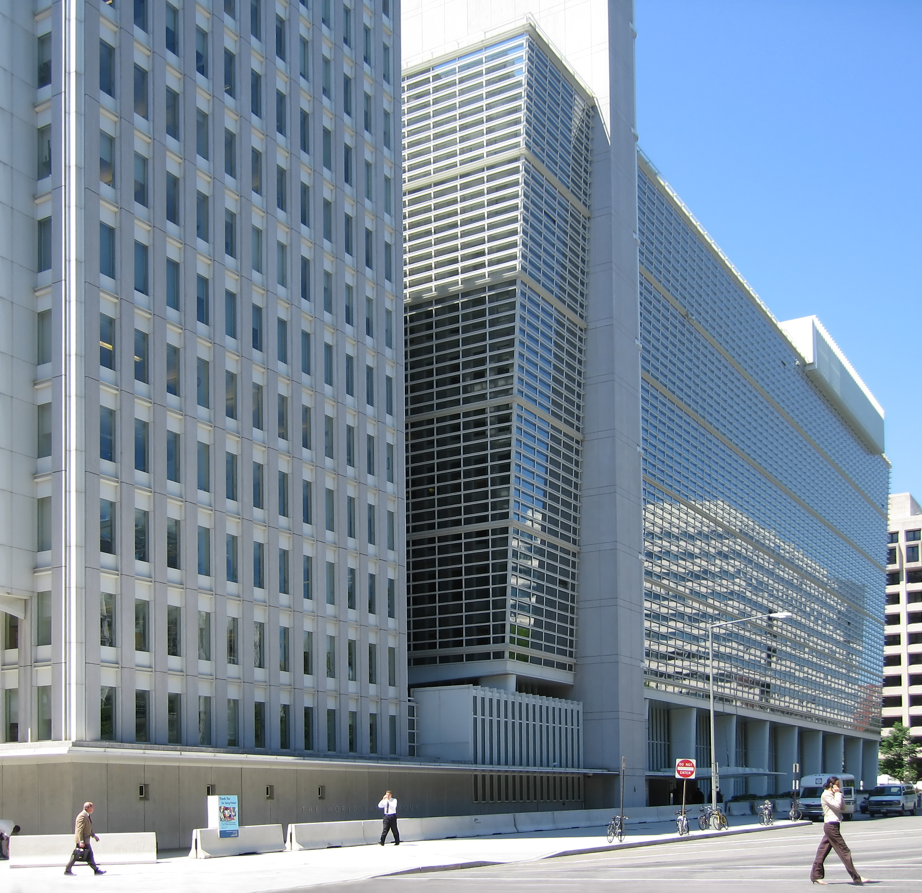
Criminogenic Nature of Organizations
Edward Gross asserted that all organizations are inherently criminogenic (prone to committing crime), though not necessarily criminal.

Slide 4





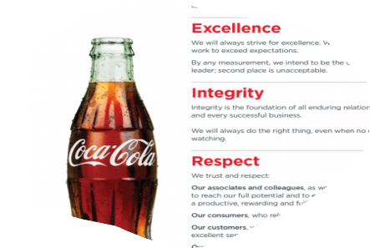









Integrity is Key

Slide 5
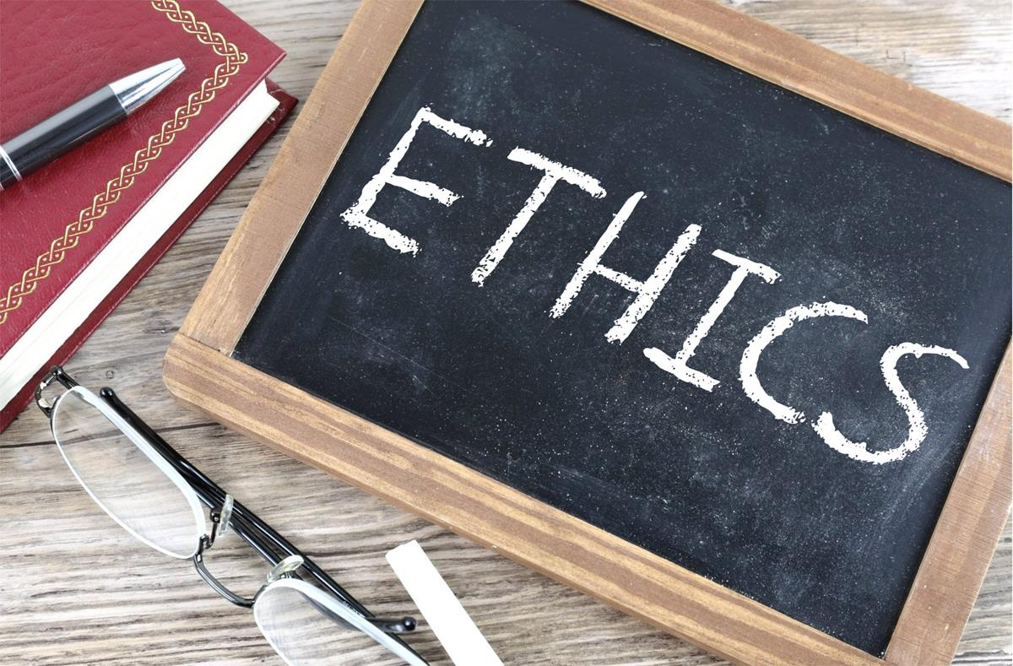
Ethics refers to a set of moral principles or values that guide human behavior. It involves distinguishing between right and wrong, good and bad, and making decisions that align with moral standards.

Slide 6
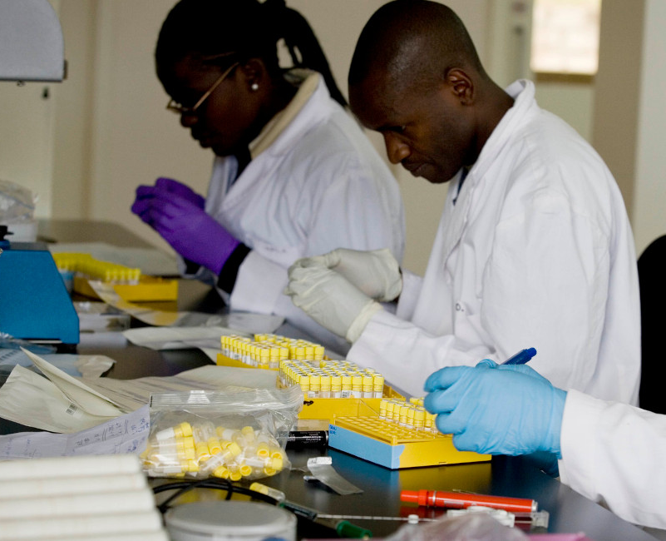

During the last testing phase of a project, you discover evidence that suggests potential health risks associated with the drug.

Slide 7




ETHICAL DILEMMAS – WHEN RIGHT IS NOT RIGHT
TRUTH VERSUS LOYALTY
INDIVIDUAL VERSUS COMMUNITY
This dilemma involves the conflict between the need to share information and the value of upholding implicit or explicit promises to do otherwise.
With this dilemma it indicates how the interest of a single person or small group of people is placed against the larger community as a whole.
COMPONENTS
Ethical dilemmas can be divided according to the types of obligations that are in conflict with each other.
SHORT TERM VERSUS LONG TERM
JUSTICE VERSUS MERCY
This dilemma focuses on how immediate benefits and risks are pitted against more distant problems and prospects .
Justice is a concept that people get what they deserve whilst mercy challenges justice as an integral part of a morally justified institution of punishment.

Slide 8

ETHICAL PITFALLS
They usually involve situations where the right choice is not clear cut and there's a risk of compromising one's values or the trust others have in you.

Slide 9

Conflict of Interest
When personal interests or relationships influence professional judgment or decision-making, potentially compromising objectivity.
3.3.2 We do not exercise the power of our expertise or position to influence the decisions or actions of others in order to benefit personally at their expense
Perceived
Potential
Actual

Slide 10
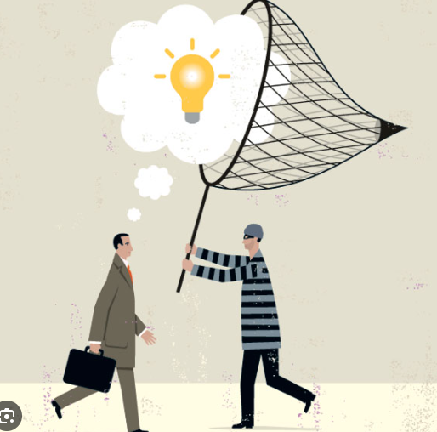
Plagiarism and Intellectual Property Issues
Using someone else's ideas, work, or words without proper attribution or permission.
3.3.4 We respect the property rights of others.

Slide 11
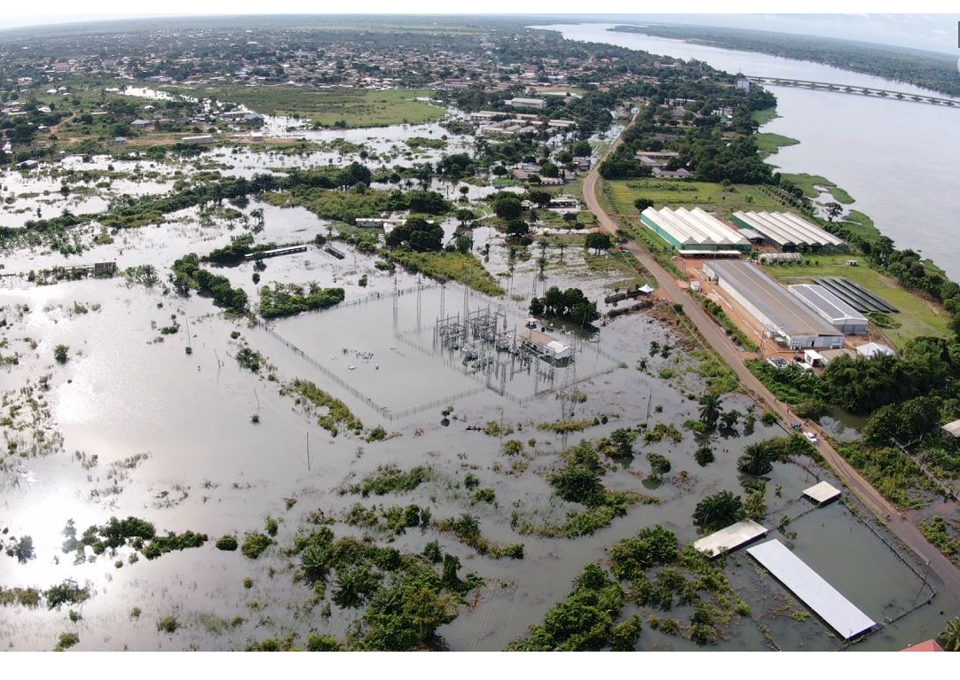
Environmental Impact
Ignoring or downplaying the environmental consequences of actions or decisions.

Slide 12
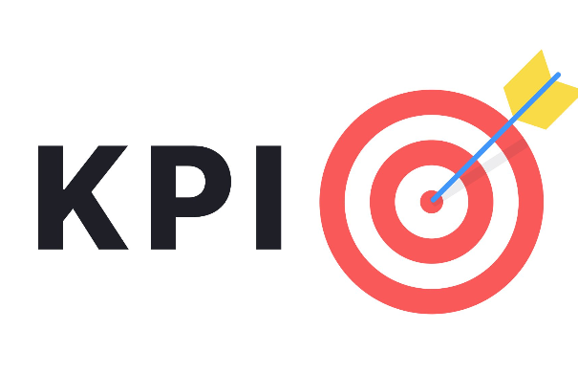
Lack of Transparency
Withholding relevant information or being unclear about motives or intentions, which can undermine trust.
Involve
Inform
Inspire
=
+
+
Key Performance Indicator

Slide 13
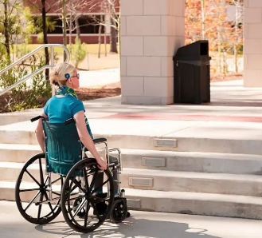
Bias and Discrimination
Treating individuals or groups unfairly based on personal biases such as race, gender, religion, or socioeconomic status.

Slide 14

Handling Incompetent Staff and Contractors
Involves a fair but firm approach. It is important to set clear expectations and communicate where they're falling short. Escalation and Termination should happen if need be.

Slide 15
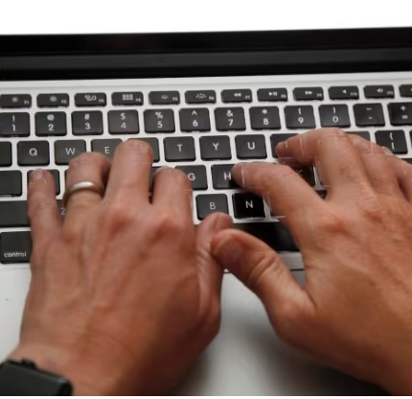
Confidentiality Breaches
With sensitive information such as plans, contracts, and financial details being shared, the risk of confidentiality breaches looms large. A breach can have severe consequences, including legal disputes, reputational damage, and financial losses.

Slide 16

Receiving “Gifts” From Vendors and Customers
In some cases , accepting gifts from clients or vendors can create conflicts of interest and compromise the integrity of the business relationship . It may also be seen as a form of bribery or influence - peddling , which can be unethical and even illegal.

Slide 17
PMI VALUES
  It is our duty to take ownership for the decisions we make or fail to make, the actions we take or fail to take, and the consequences that result.
  show a high regard for ourselves, others, and the resources entrusted to us. Resources entrusted to us may include people, money, reputation, the safety of others, and natural or environmental resources
RESPONSIBILITY
RESPECT
Practitioners from the global project management community were asked to identify the values that formed the basis of their decision making and guided their actions.
HONESTY
FAIRNESS
  understand the truth and act in a truthful manner both in our communications and in our conduct
  Make decisions and act impartially and objectively. Our conduct must be free from competing self interest, prejudice, and favoritism.

Slide 18
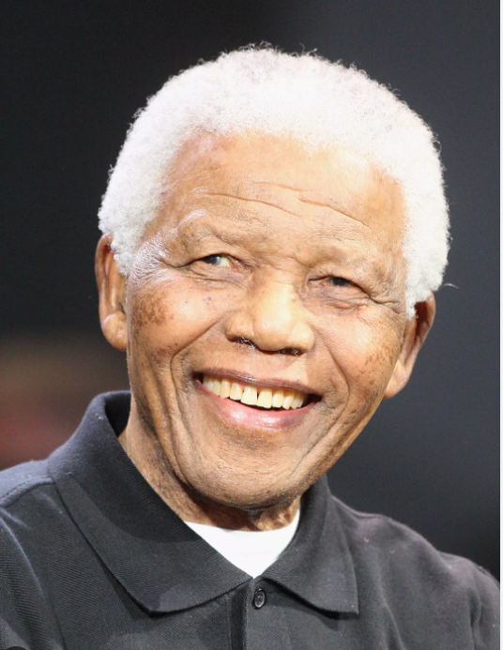
“Those who conduct themselves with morality, integrity and consistency need not fear the forces of inhumanity and cruelty”
Nelson Mandela

Slide 19
Thank you
Ransford nana addo Jnr
LEARNING FROM FAILURE; ETHICAL PITFALLS in project management
  rnaddo@gmail.com 0550940940

